Slide 1
eDofE for participants & leaders
A walkthrough of the process….
Olivia Simpson – Hampshire Scouts Top Awards ambassador
V3 - Updated Feb 2018

Slide 2
Participant registers online/via paper form
LO sets up eDofE account
Participant gets welcome email with username, password & eDofE number

Slide 3
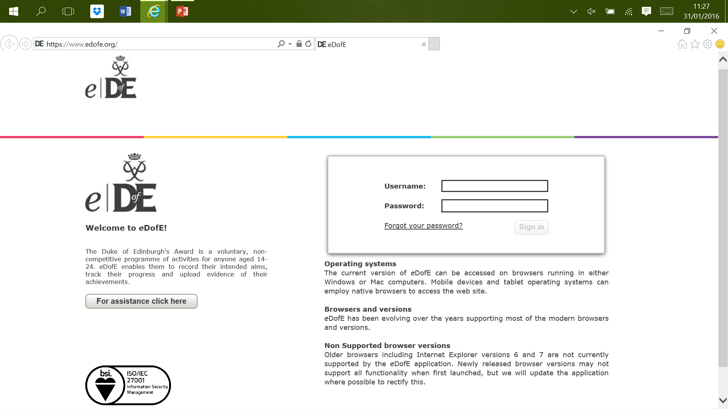
www.edofe.org
Login

Slide 4
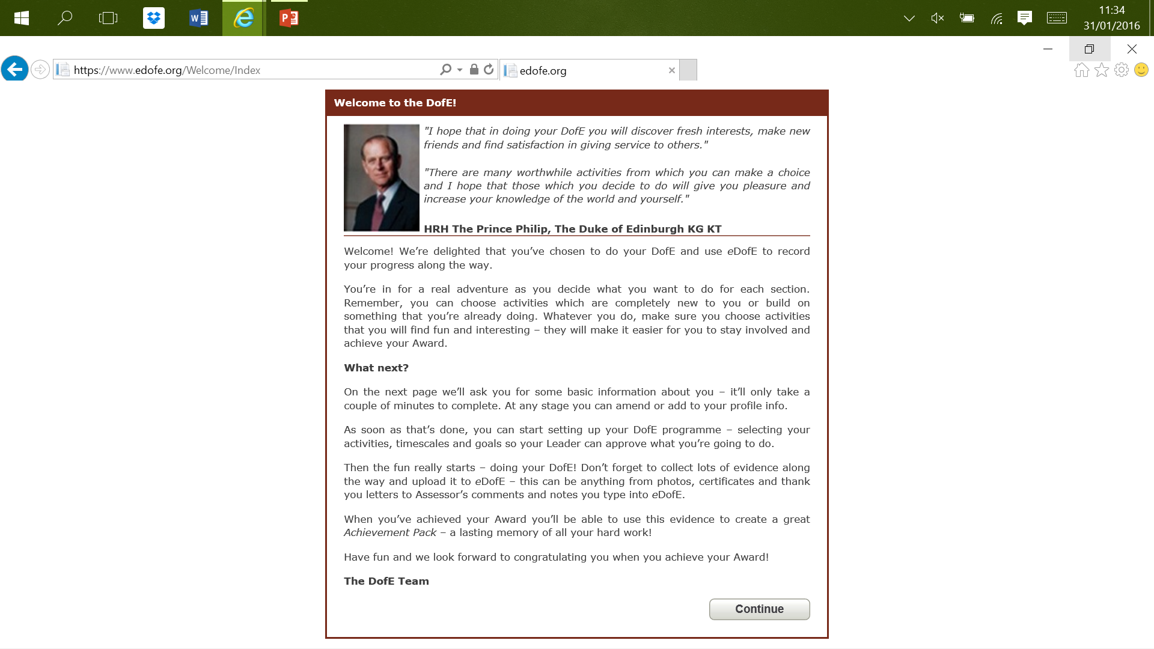
Welcome from Prince Philip

Slide 5
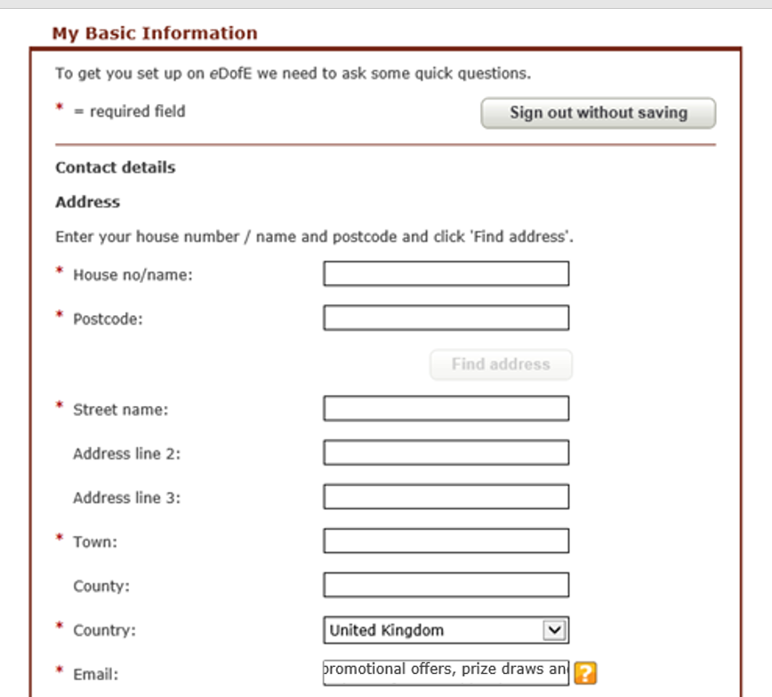
Complete mandatory information

Slide 6
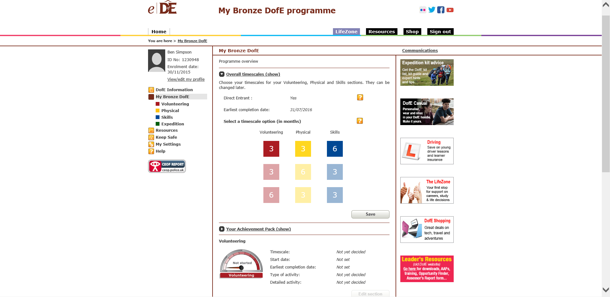
Choose timescales & save
Note that you cannot change timescales if any section including the Residential at Gold is completed. You need to reopen them for the participant to change!
They can also access later via My Bronze DofE

Slide 7
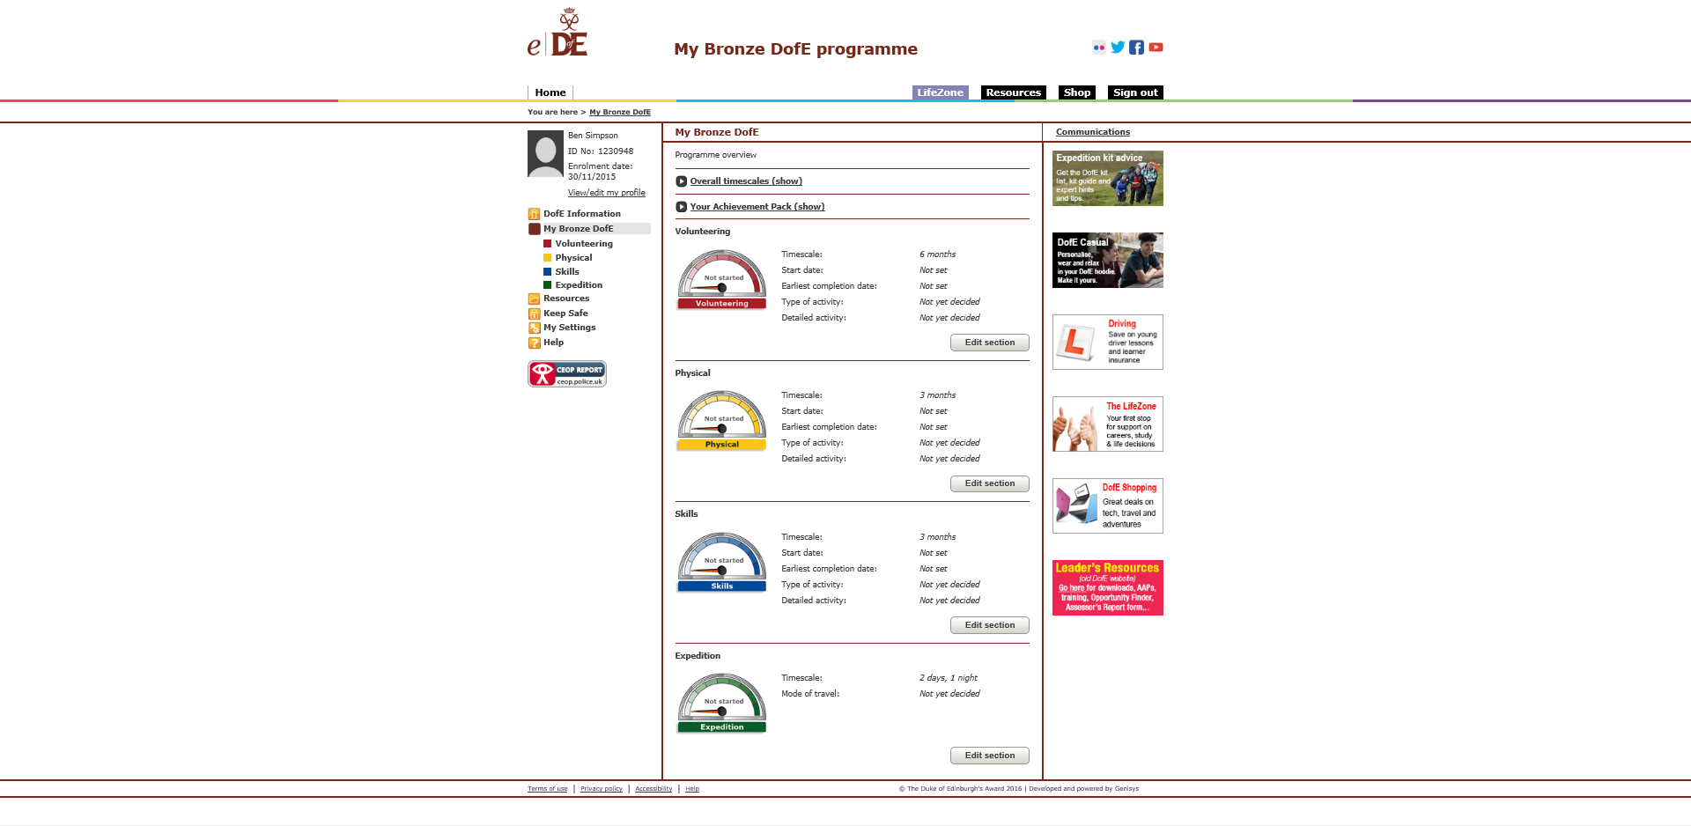
Click edit section to complete programme planner

Slide 8
Complete form, choose leader & submit
Participants can save as draft – but the section cannot be approved unless all * boxes are completed

Slide 9
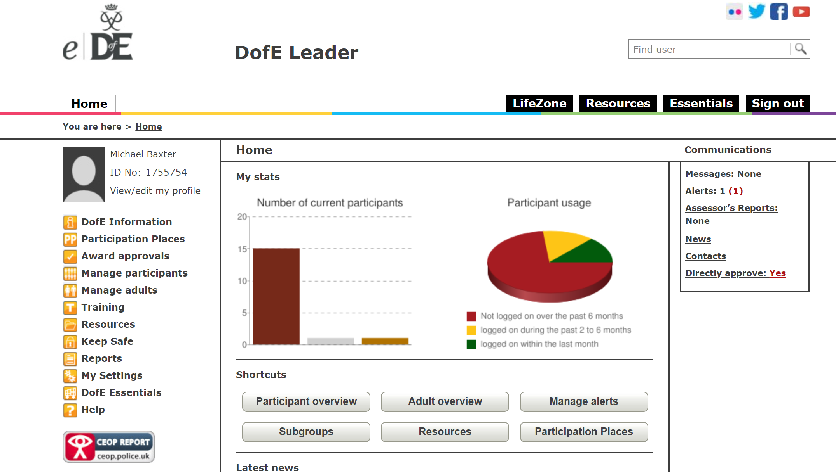
How to approve programme planners
The alert pops up for your to approve here

Slide 10
Check and approve if OK, otherwise query.
Click on the alert to view what needs approval

Slide 11
Participant completes programme planner
Leader approves programme planner
The participant now starts their activity averaging an hour per week. They can add evidence as they go.
For example – photographs, documents, comments
- Leaders can add evidence too.
The minimum evidence is an assessor report.

Slide 12
How participants add evidence on eDofE
Add evidence

Slide 13
How leaders can add evidence to participants
3. Tick if assessor report
4. Add evidence to one or more people
2. Select type
1. Add evidence under Manage Participants

Slide 14
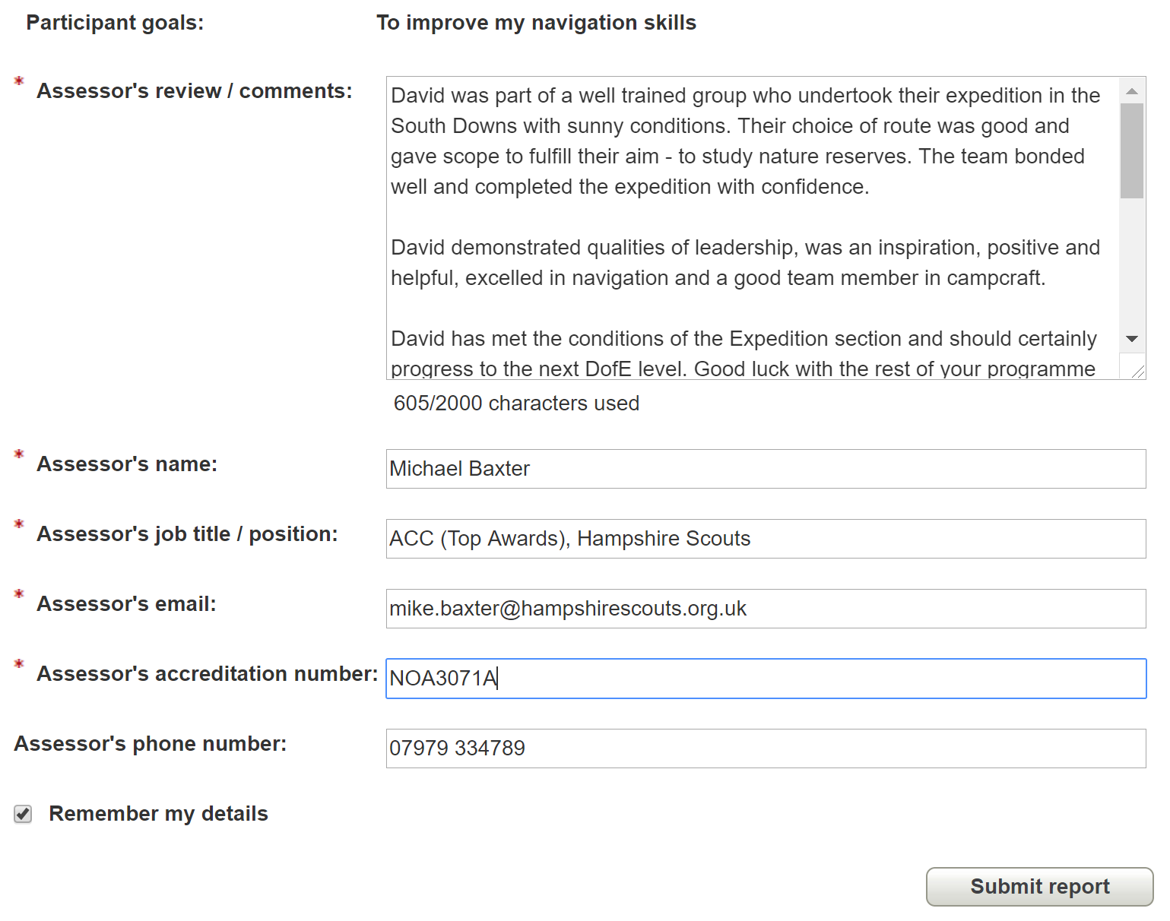
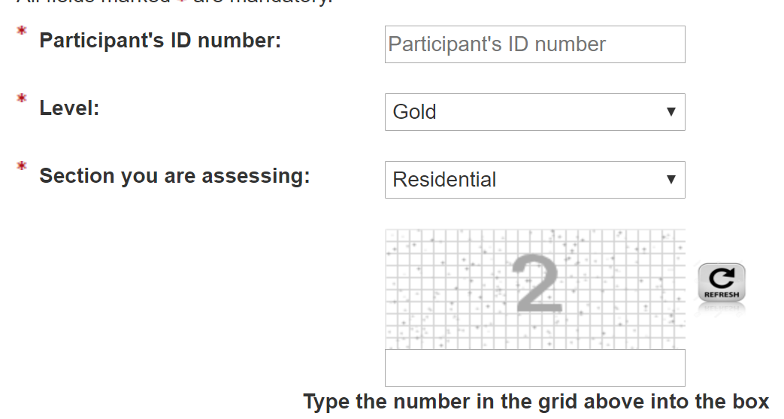
How assessors can add reports online
www.edofe.org/assessors
Use EDofE number, level & section
Check name
Submit

Slide 15
Alert pops up for you to approve
How to approve assessor reports
Select the report
Send to participant

Slide 16
How to sign off a DofE section
Programme planner complete
Minimum time met
Assessor report online (minimum evidence)
Additional evidence (if required)
- The evidence must show regular commitment and progression before it is approved

Slide 17
Step 1 – Find participant using Participant Overview
Search for participants

Slide 18
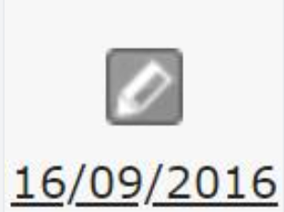
Step 2 – Look participants profile
Section complete
Section in draft
Alert needs attention
View profile
In progress
Section not started

Slide 19
Step 3 – Review evidence & approve
Ensure you enter correct end date as the section of the next award can be started from this date.
Assessor report
Directly approve the section
View other evidence e.g. photos
Enter end date & save

Slide 20
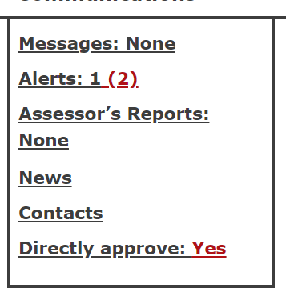
Directly approve function
Directly approve shows participants with sections with a completed programme planner, correct duration & assessor report online
Click on ‘Directly Approve’
Sections with a symbol are ready for checking and approval if all evidence is acceptable

Slide 21
Training
Qualifying
The Expedition Section
Practice
Assessor report
Presentation
Hover over for summary information

Slide 22
Setting up expeditions
It is easiest for leaders to setup the expedition for their participants via ‘Expedition Set Up’
You can create a ‘Subgroup’ to set up the expedition for whole expedition group. This is only visible to the leader who sets it up.

Slide 23
2. Name group e.g. Silver
Creating a Subgroup
1. Manage participants then Subgroups
3. Add members

Slide 24
Expedition Setup
1. Manage participants then Exped setup
2. Select subgroup or participant

Slide 25
Expedition Training

Slide 26
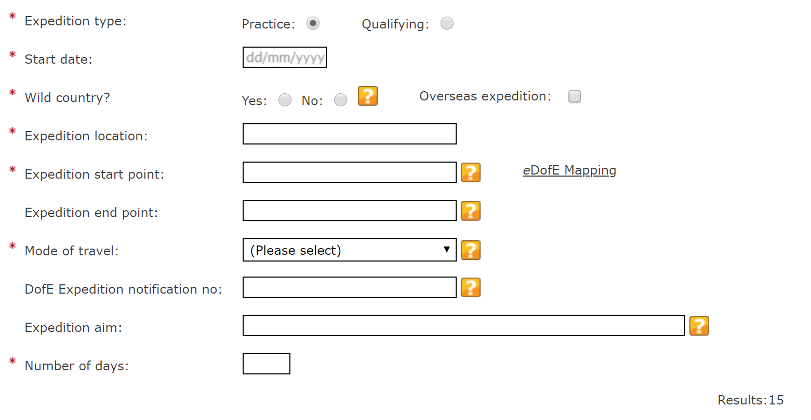
Practice Expedition
Postcode or grid reference
Print Green Notification Form

Slide 27
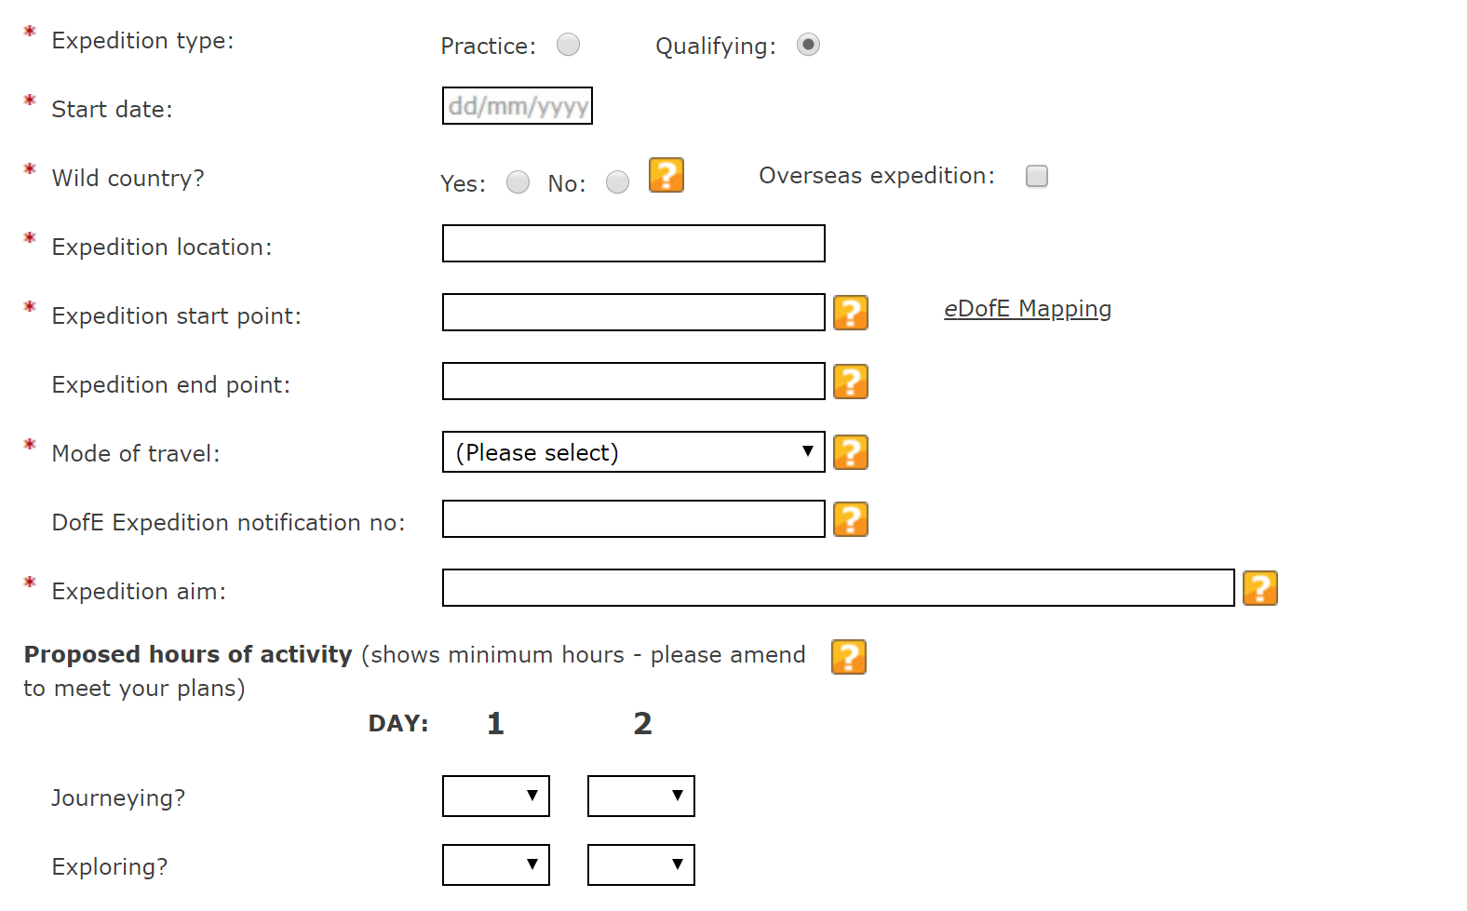
Qualifying Expedition
Hours of planned activity

Slide 28
Presentation information

Slide 29
Adding expedition to other participants
LP – Practice added by leader
LQ – Qualifying added by leader
PP – Practice added by participant
PQ – Qualifying added by participant
PEx – Old style practice
QEx – Old style qualifying
You can add an expedition to another participant in the group by clicking add and searching for the expedition number

Slide 30
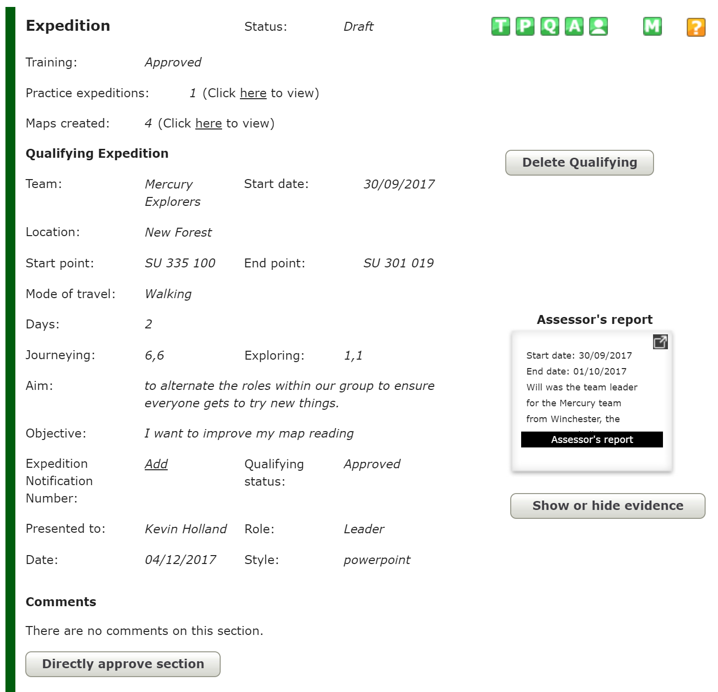
Ready to approve

Slide 31
Approving the final section of an award
Award submitted for approval
Add well done comment
Approved award
Send award for approval

Slide 32
Viewing approved awards

Slide 33
Adding news for participants

Slide 34
Resources – mapping and more….
Access free OS mapping
Access DofE resources
Add resources for leaders

Slide 35
Downloading reports
Ask your LO to give you permission to download reports

Slide 36
My settings
Customise quick links

Slide 37
Edit profile
Click to edit password etc.

Slide 38
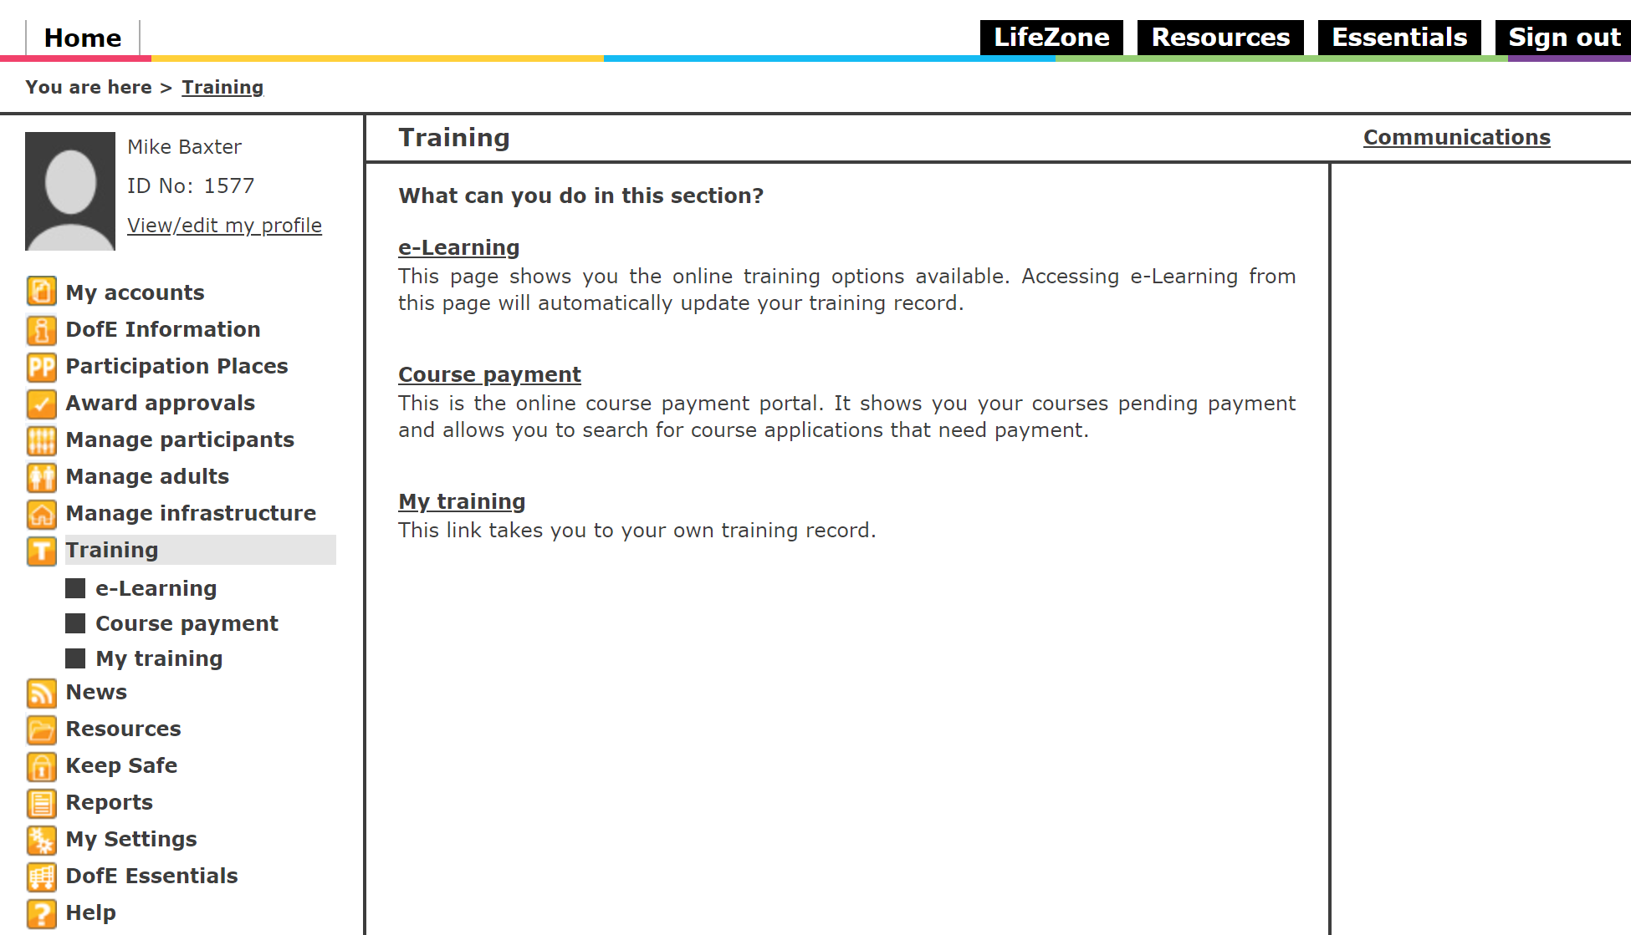
Training & e-learning

Slide 39
Lost password
Look up username
Check email correct
Username
Email address

Slide 40
Forgotten password link
Forgotten Password
Enter username
Challenge question or Can’t remember to get a password emailed

