Slide 1
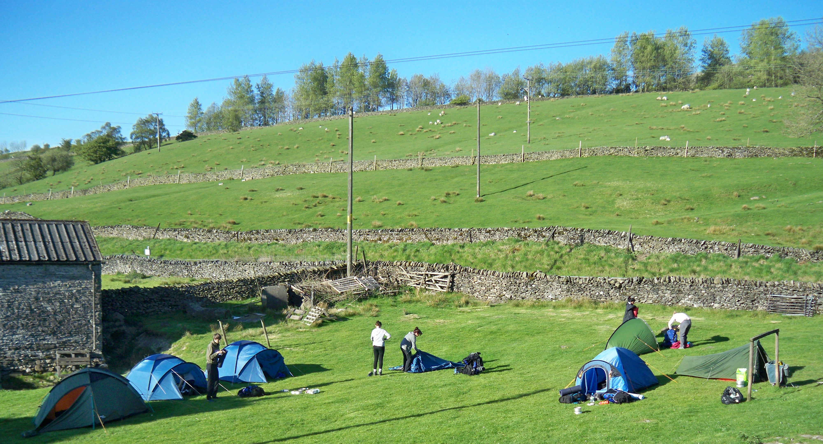
Camping on campsites

Slide 2
Arriving on the site
Camping on a campsite
Introduce yourself to the people running the site.
You need to clarify:
  You are in the right place
  Where they want you to pitch your tents
  Where everything is is
  If there are any site rules you need to know
Have a quick snack
Work out who is doing what. Are you going to get tents up then cook, or do both
Notes:
<click> If your supervisor or assessor is on the site then they may have already found out where everything is, if not then find the owner.
<click>
Sometimes there are a few sites on in the same immediate area (though maybe only one or none marked on the map)<click><click><click>
<cclick> Have a very quick snack to replenish your energy stores
<click> always get your tents up fast in case it rains, consider half the group putting tents up half the group getting water on the boil.

Slide 3
Where to camp
Camping on a campsite
Things to consider when choosing your pitch
Shelter
Other campers
Slope
Prevailing wind
Ground conditions
Hazards (tree cover,
power lines)
Clear stick and loose
stones
Sunrise
Notes:
<Click> Is it windy? work out where the wind is coming from, is there a wall or bump to shelter behind?
<click> keep away from other campers if you can. If you are close then introduce yourself and ask them to let you know if you are bothering them
<click> get a flat spot, if not totally flat pitch with your head end up hill
<click> some tents are streamlined and will be a lot quieter (and more waterproof) if pitched with the right bit pointing into the wind (see picture of streamlined tent, back to the wind)
<click> don’t pitch in a bog, if it rains it will get boggier
<click> avoid camping under trees if possible. Some trees drip sticky sap or bird poo which will need cleaning off, if it rains in the night then they will drip water for longer than it is raining for. There is a danger of small branches breaking off on windy nights too
<click> uncomfortable and may make a hole in the groundsheet
<click> You’ll be OK in September but in June and July it is good to try and get shade from the rising sun if possible

Slide 4

Other tips
Camping on a campsite
Bring something to do
Keep your camp tidy
Set up a rubbish bag
Put your rubbish in the bin before you go to bed
Pick up any spilled food
Keep your food in your tent
Keep your gas cannister in the porch
Notes:
<click> not so much of a problem at gold, you might want a book, or playing cards, at bronze a frizby or ball might be good for passing time…
<click> Don’t pull lots of stuff out of your bag, if it starts raining or the wind picks up you will regret it. Keep tent doors zipped up when you are not there (security but mainly stability / rain)
<click> no point putting rubbish like matches, food packaging etc on the floor, you only have to pick it up again. Put it straight in a bag
<click> these are all about not having foxes, rats, mice and dogs hanging around your tent. A rat in your porch will keep you awake for hours
<click> There is a tiny chance that if your gas may leak (though I have never heard of this happening), best keep it in the porch

Slide 5
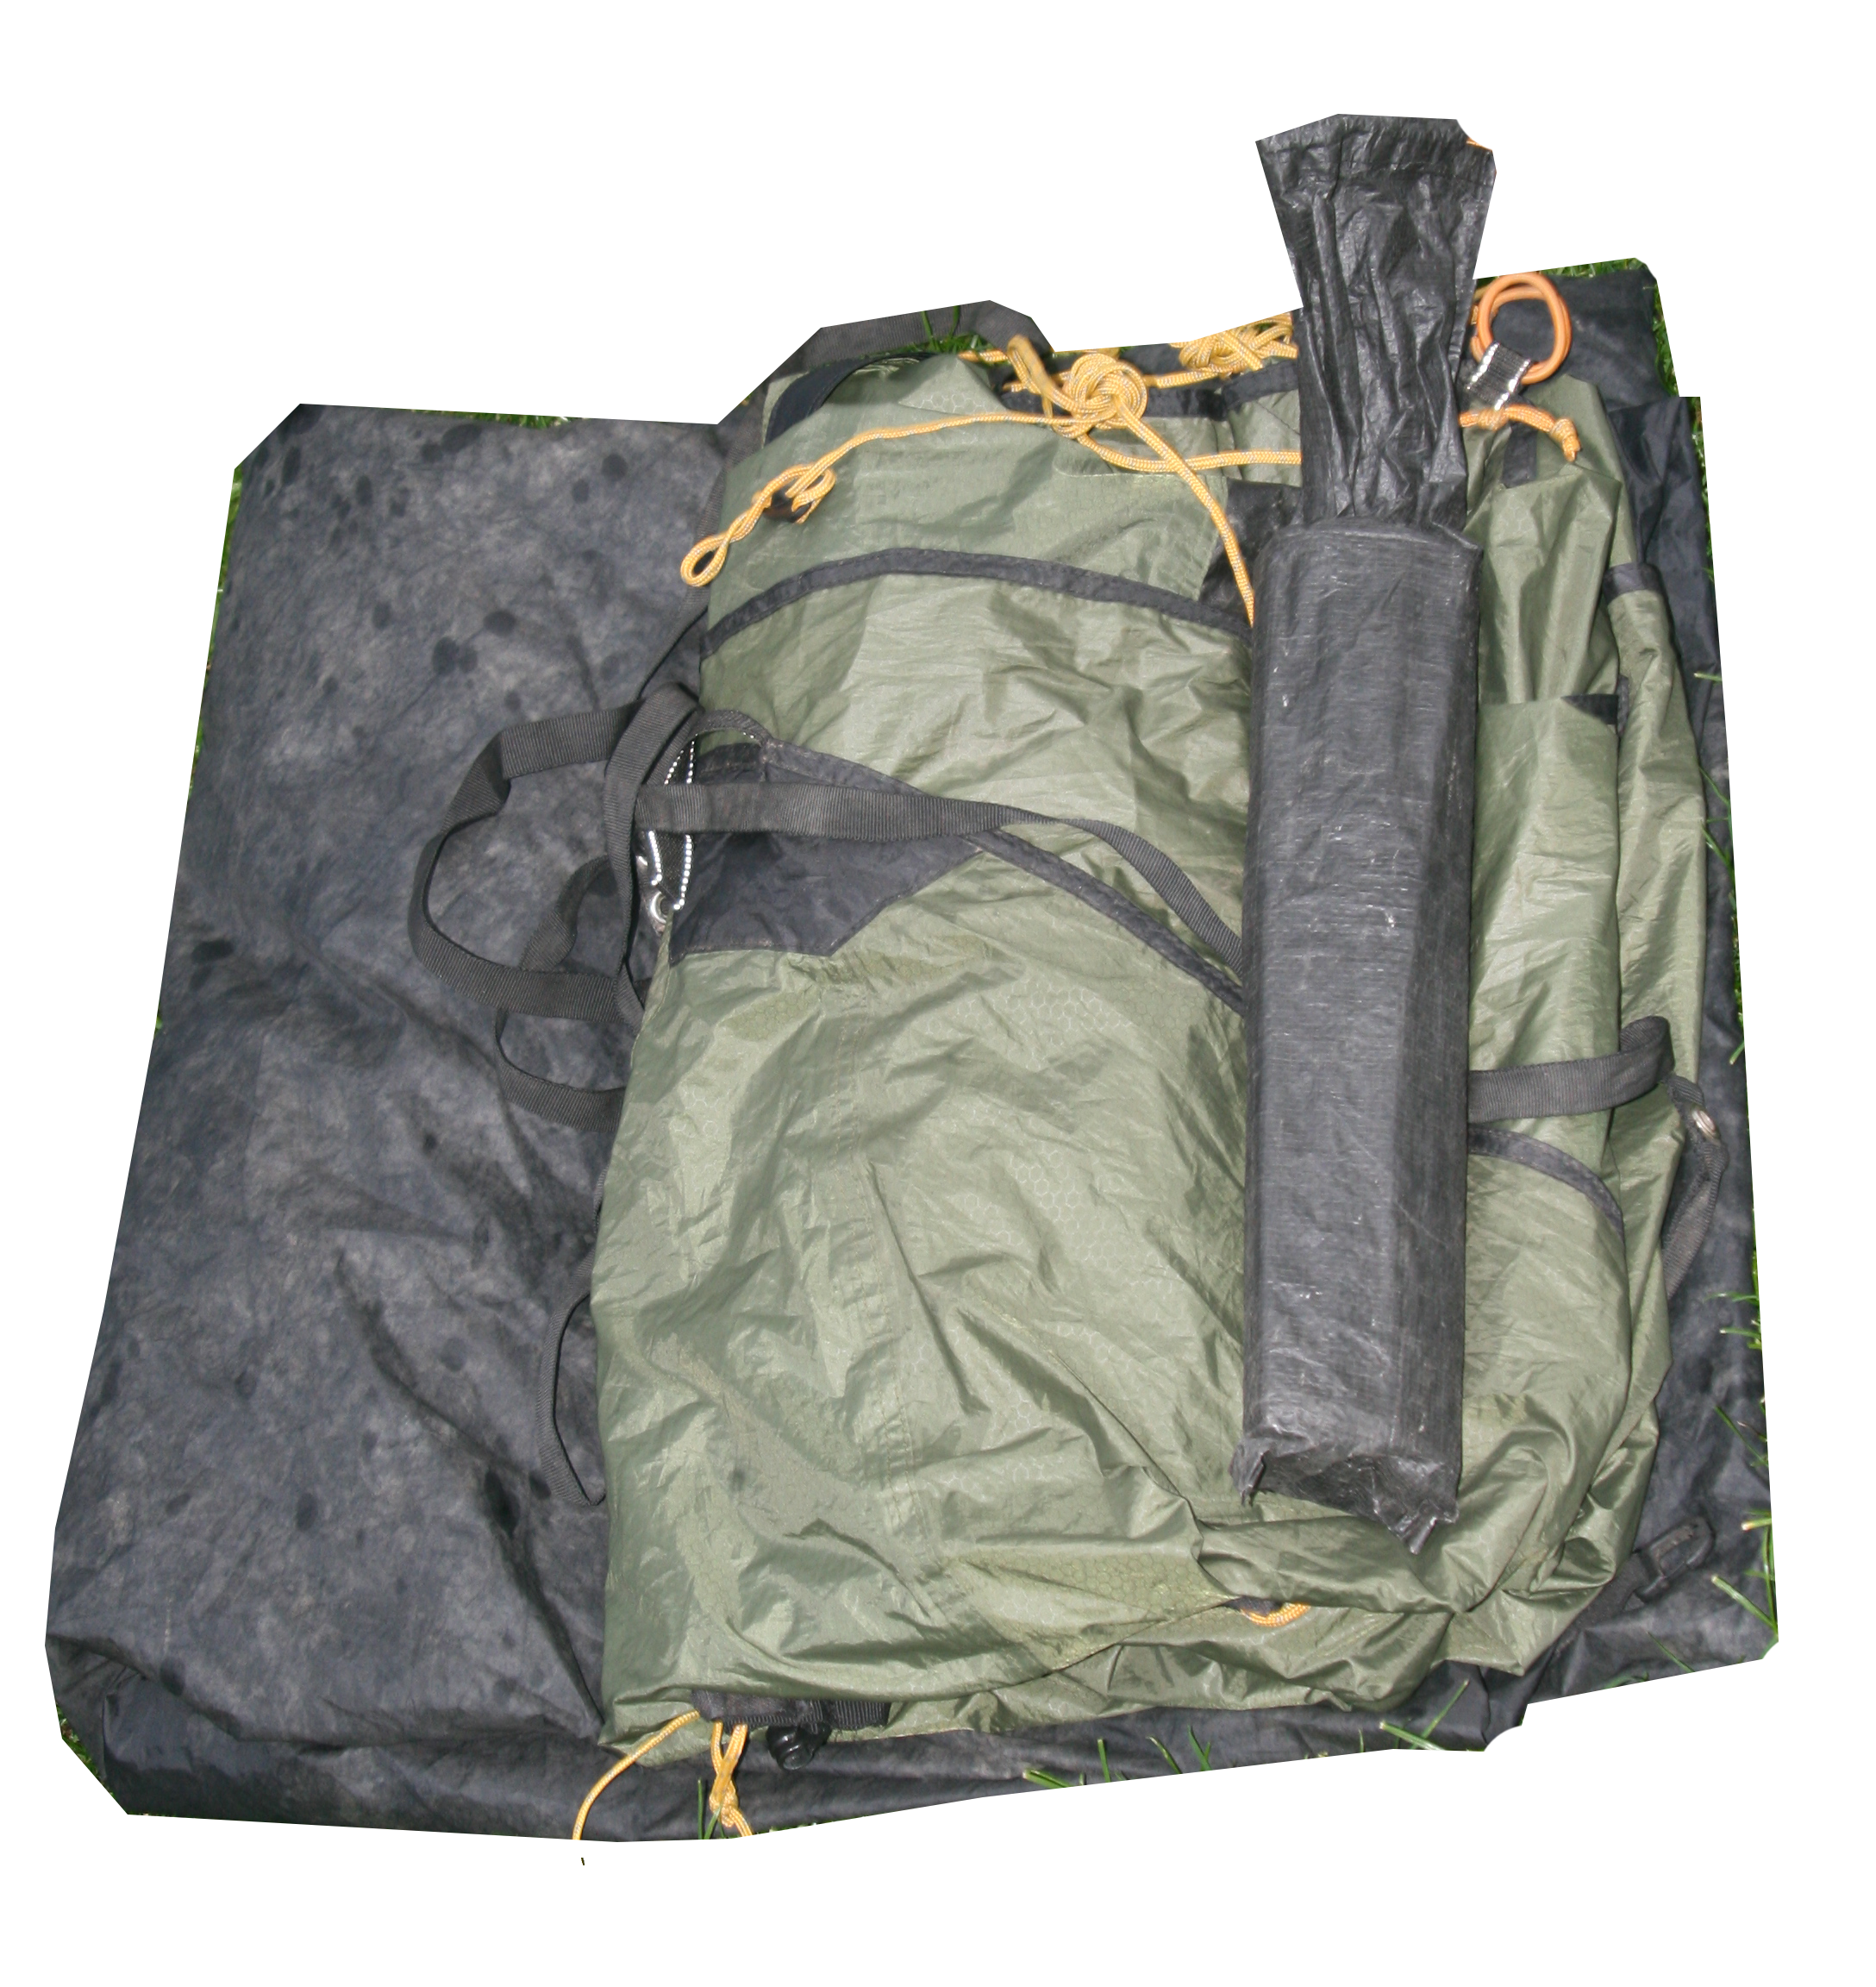
Striking camp
Camping on a campsite
Packing up sounds easy but can take ages
Communicate with the other occupant of your tent
Wake up the rest of the team (they are probably already awake or dozing)
Set a leaving time as soon as you are all awake and work to that time
Work as a team. You should always be doing something
Final litter and food waste sweep
Notes:
<click> or if you don’t like communication, if they have left the tent use that time to pack up your stuff
<click> no point everyone lying there thinking is everyone else awake
<click> everyone wants to know where they stand
<click> It doesn’t have to be hectic, but you find yourself standing around, think about what needs doing for you or others. (usually help with cooking, washing up and taking the tent down is appreciated)
<click> keep a small bag open for the final litter sweep and bit it on the way out

Slide 6
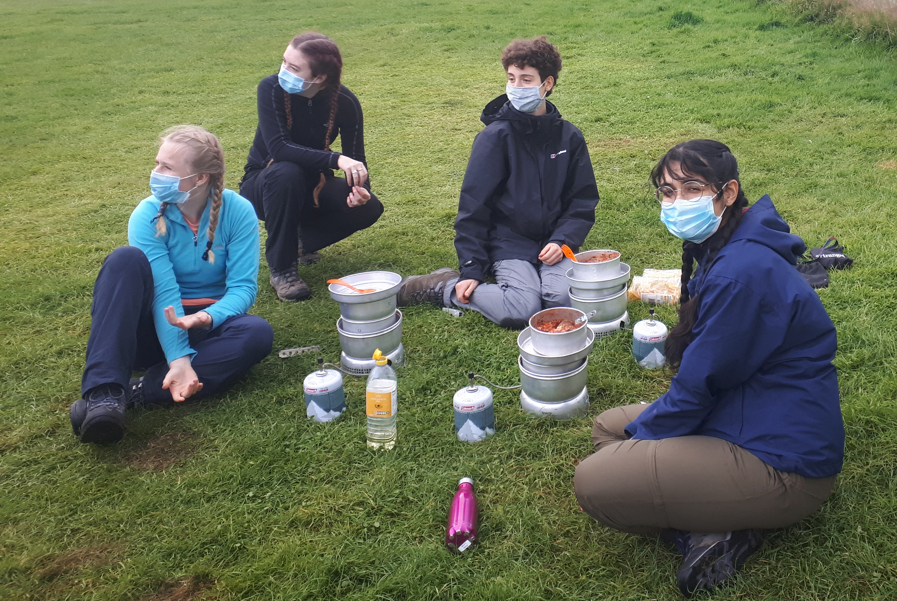
Camp Hygiene
Camping on a campsite
Hand hygiene
Washing up strategy
Extra covid precautions when cooking
Have sanitiser at your cooking station
Wear a mask
Choose boil in the bag or dehydrated foods
Don’t double dip when tasting
Cooking hygiene monitor?
Notes:
Click> Hand hygiene is always important when camping, especially in a group. We always teach it but now has more importance.
<click> Normally we would say no more than wash your hands, don’t wash up individually in the same water but have one person wash their hands & wash up for everyone (or use fresh water).
<click> You must sanitise if you touch your face
<click> wearing a mask means you won’t touch your mouth or nose
<click> more hygienic (not as interesting though) (you probably, don’t need a mask either)
<Click> If you do cook properly, have a couple of tasting utensils and move from one pile to another if you taste with them
<Click> consider having a cooking hygiene monitor

Slide 7
Information for teachers and instructors
This presentation is designed for use alongside our ‘Course notes’ and ‘Workbook’ booklets, and lesson plans all of which are downloadable for free from our website https://www.lupineadventure.co.uk/downloads/dofe-downloads.html
or google ‘Lupine DofE downloads’.
The presentations are designed so that they can be used at all DofE levels simply tailor the depth that you go into each subject and maybe skip some slides accordingly.
The presentations are designed to be used in a classroom or remotely over Zoom / Teams etc. One of the versions of the Workbook is editable so you can ask students to fill this in and email to you, alternatively, on our website there are Google and Microsoft Forms relating to some lessons that you can copy to your accounts and share with students.
You are free to edit the presentation for your organisation however you wish but please don’t distribute further, we would rather you point people to our website.
If you would like to be informed of future releases then subscribe to our mailing list from our website.
If you would like early copies of, and to be involved in shaping, future resources then join our Facebook group for this purpose https://www.facebook.com/groups/859994524494945/
Lupine Adventure Co-op are an approved activity provider for the expedition section of the DofE. Please do get in touch if you would like assistance with running any part, or all of your expedition programme.

